Slide 1
Chapter 2 Determinants

Slide 2
Chapter Content
2.1 The Determinant Function
2.2 Evaluating Determinant Function
2.3 Properties of the Determinant Function
2.4 Cofactor Expansion; Cramer’s Rule

Slide 3
2.1 The Determinant Function

Slide 4
Definition
A permutation of the set of integers {1,2,…,n} is an arrangement of these integers in some order without omission repetition

Slide 5
Example 1
Permutations of Three Integers
There are six different permutations of the set of integers{1,2,3}.These are
(1,2,3) (2,1,3) (3,1,2)
(1,3,2) (2,3,1) (3,2,1)

Slide 6
Example 2
Permutations of Four integers(1/2)
List all permutations of the set of integers{1,2,3,4}
Solution: The different permutation are all possible paths through the ”tree” from first position to the last position
Figure 2.1.1
1
2
3
4
2
3
4
1
3
4
1
2
4
1
2
3
3
4
2
4
2
3
3
4
1
4
1
3
2
4
1
4
1
2
2
3
1
3
1
2
4
3
4
2
3
2
4
3
4
1
3
1
4
2
4
1
2
1
3
2
3
1
2
1

Slide 7
Example 2
Permutations of Four integers(2/2)
We obtain the following list by this process
(1,2,3,4) (2,1,3,4) (3,1,2,4) (4,1,2,3)
(1,2,4,3) (2,1,4,3) (3,1,4,2) (4,1,3,2)
(1,3,2,4) (2,3,1,4) (3,2,1,4) (4,2,1,3)
(1,3,4,2) (2,3,4,1) (3,2,4,1) (4,2,3,1)
(1,4,2,3) (2,4,1,3) (3,4,1,2) (4,3,1,2)
(1,4,3,2) (2,4,3,1) (3,4,2,1) (4,3,2,1)

Slide 8



Inversion
An inversion is said to occur in a permutation whenever a larger integer precedes a smaller one.
The total number of inversions that less than
can be obtained as follow:
(1) find the number of integers that are less than j₁ and that follow j₁ in the permutation;
(2) find the number of integers that are less than j₂ and that follow j₂ in the permutation; Continue the process for
The sum of these number will be the total number of inversions in the permutation.

Slide 9
Example 3
Counting Inversions
Determine the number of inversions in the following permutations:
(a) (6,1,3,4,5,2) (b) (2,4,1,3) (c ) (1,2,3,4)
Solution:
(a) The number of inversions is 5+0+1+1+1=8.
(b) The number of inversions is 1+2+0=3.
(c) There no inversions in this permutation.

Slide 10
Definition
A permutation is called even if the total number of inversions is an even integer and is called odd if the total inversions is an odd integer.

Slide 11
Example 4
Classifying Permutations
The following table classifies the various permutations of {1,2,3} as even or odd.
Permutation | Number of Inversions | classification
(1,2,3) (1,3,2) (2,1,3) (2,3,1) (3,1,2) (3,2,1) | 0 1 1 2 2 3 | even odd odd even even odd

Slide 12
Definition of a Determinant
By an elementary product from an nxn matrix A we shall mean any product of n entries from A, no two of which come from the same row or same column

Slide 13
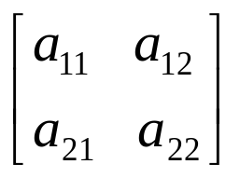
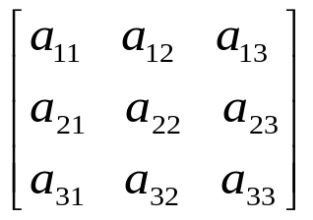




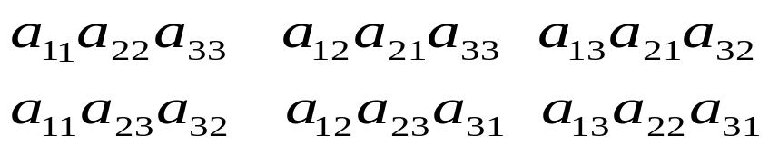
Example 5
Elementary Products
List all elementary products from the matrices
(a) (b)
Solution (a):
an elementary product can be written in the form
Since no two factors in the product come from the same column, so the elementary products are and
Solution (b):
an elementary product can be written in the form
The following list of elementary products are

Slide 14


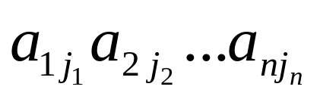
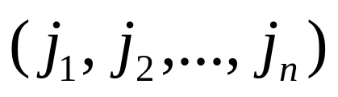
Signed Elementary product
An matrix A has elementary products. There are the products of the form ,where is a permutation of the set {1,2,…,n}. By a signed elementary product from A we shall mean an elementary multiplied by +1 or -1 . We use + if is an even permutation and – if is an odd permutation.

Slide 15



Example 6
Signed Elementary Products(1/2)
List all signed elementary products from the matrices
(a) (b)
Solution:
(a)
Elementary Product | Associated Permutation | Even or Odd | Signed Elementary Product
 | (1,2) (2,1) | even odd

Slide 16









Example 6
Signed Elementary Products(2/2)
(b)
Elementary Product | Associated Permutation | Even or Odd | Signed Elementary Product
 | (1,2,3) (1,3,2) (2,1,3) (2,3,1) (3,1,2) (3,2,1) | even odd odd even even odd

Slide 17
Definition
Let A be a square matrix. The determinant function is denoted by det, and we define det(A) to be the sum of all signed elementary products from A. The number det(A) is called the determinant of A.

Slide 18
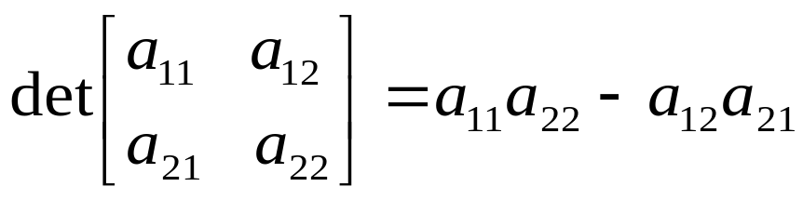
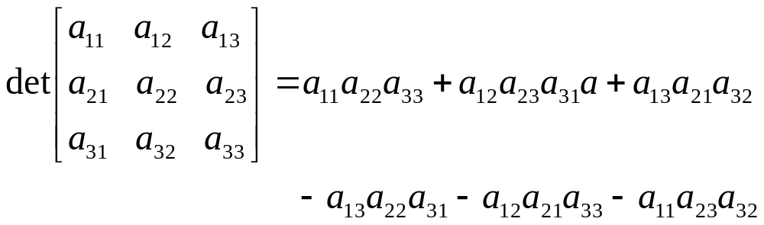
Example 7
Determinant of 2x2 and 3x3 matrix
Referring to Example 6, we obtain
(a)
(b)

Slide 19

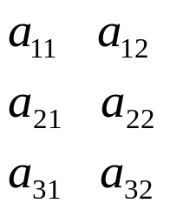
Using mnemonic to obtain determinant
The determinant is computed by summing the products on the rightward arrows and subtracting the products on the leftward arrows.
(a) Determinant of a 2x2 matrix (b) Determinant of a 3x3 matrix
Figure 2.1.2

Slide 20
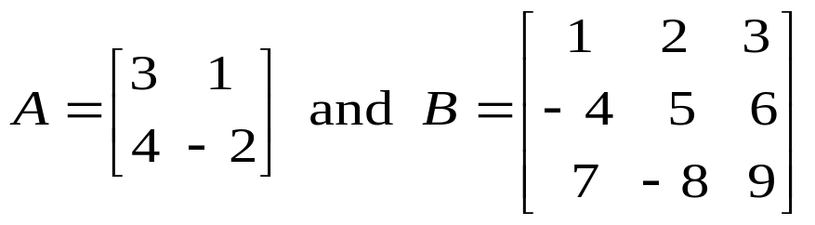
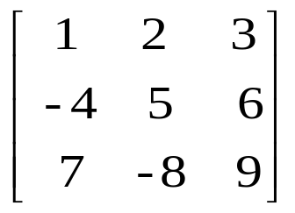
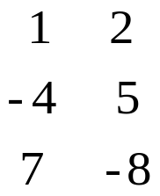
Example 8
Evaluation Determinants
Evaluating the determinants of
Solution:
Using the method of figure 2.1.2a gives
det(A) = (3)(-2) - (1)(4) = -10
Using the method of figure 2.1.2b gives
det(B) = (45) + (84) + (96) - (105) - (-48) - (-72) = 240

Slide 21
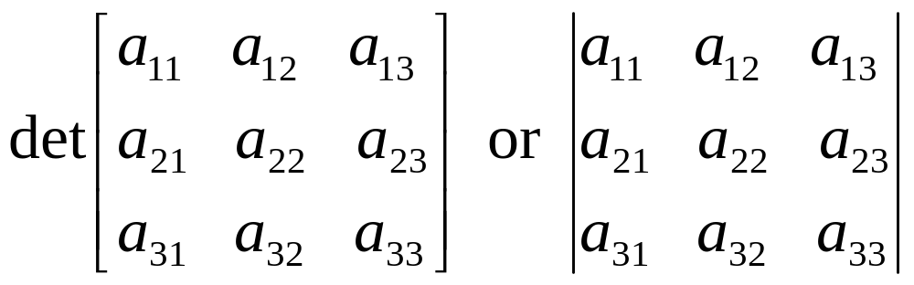
Notation and Terminology(1/3)
We note that the symbol |A| is an alternative notation for det(A). For example, the 3x3 matrix can be written as

Slide 22
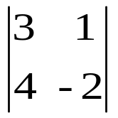
Notation and Terminology(2/3)
Strictly speaking, the determinant of a matrix is a number. However, it is common practice to “abuse” the terminology slightly and use the term “determinant” to refer to the matrix whose determinant is being computed. Thus, we might refer to
as a 2x2 determinant and call 3 the entry in the first row and first column of the determinant.

Slide 23
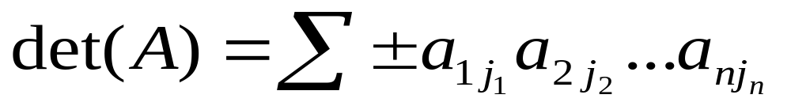

Notation and Terminology(3/3)
We note that the determinant of A is often written symbolically as
where indicates that the terms are to be summed over all permutations
and the + or – is selected in each term according to where the permutation is even or odd.

Slide 24
2.2 Evaluating Determinants By Row Reduction

Slide 25
Theorem 2.2.1
Let A be a square matrix
(a) if A has a row of zeros or a column of zeros, then det(A) = 0.
(b) det(A) = det(A^{T})

Slide 26
Theorem 2.2.2
Triangular Matrix
If A is an nxn triangular matrix (upper triangular, lower triangular, or diagonal), then det(A) is the product of the entries on the main diagonal of the matrix ; that is, det(A) = a₁₁a₂₂…a_{n}.

Slide 27
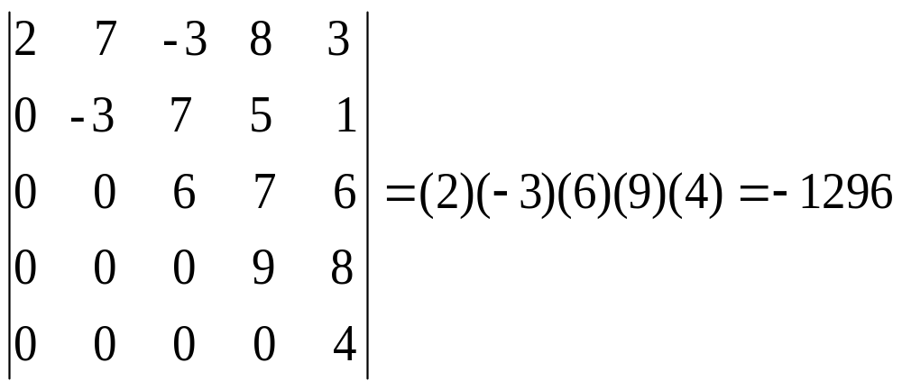
Example 1
Determinant of an Upper Triangular

Slide 28
Theorem 2.2.3
Elementary Row Operations
Let A be an nxn matrix
(a) If B is the matrix that results when a single row or single column of A is multiplied by a scalar k, than det(B) = k det(A)
(b) If B is the matrix that results when two rows or two columns of A are interchanged, then det(B) = - det(A)
(c) If B is the matrix that results when a multiple of one row of A is added to another row or when a multiple column is added to another column, then det(B) = det(A)

Slide 29
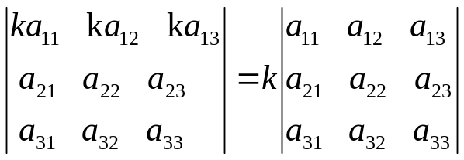
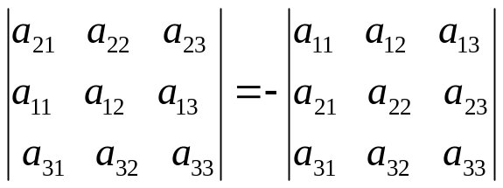
Example 2
Theorem 2.2.3 Applied to 3x3 Determinants(1/2)
Relationship | Operation
det(B) =kdet(A) | The first row of A is multiplied by k.
det(B) =-det(A) | The first and second rows are interchanged

Slide 30
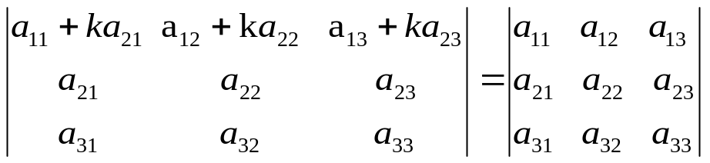
Example 2
Theorem 2.2.3 Applied to 3x3 Determinants(2/2)
Relationship | Operation
det(B) = det(A) | A multiple of the second rows of A is added to the first row

Slide 31
Theorem 2.2.4
Elementary Matrices
Let E be an nxn elementary matrix.
(a) If E results from multiplying a row of I_{n} by k, then det(E) = k
(b) If E results from interchanging two rows of I_{n}, then det(E) = -1.
(c) If E results from adding a multiple of one row of I_{n} to another, then det(E) = 1.

Slide 32
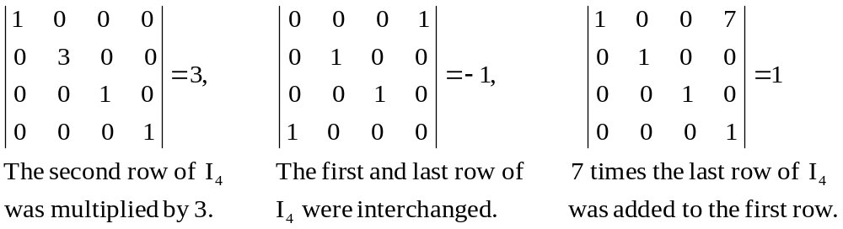
Example 3
Determinants of Elementary Matrices
The following determinants of elementary matrices, which are evaluated by inspection illustrate Theorem 2.2.4.

Slide 33
Theorem 2.2.5
Matrices with Proportional Rows or Columns
If A is a square matrix with two proportional rows or two proportional column, then det(A) = 0.

Slide 34
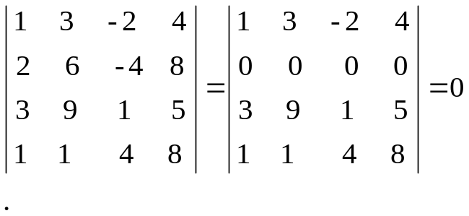
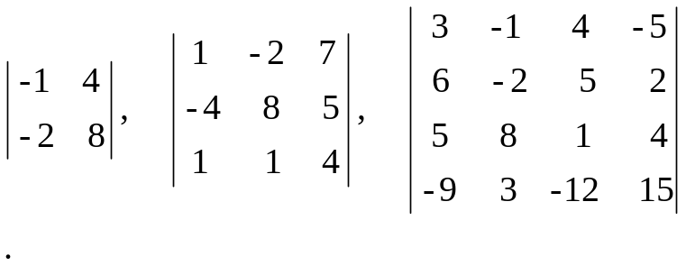
Example 4
Introducing Zero Rows
The following computation illustrates the introduction of a row of zeros when there are two proportional rows.
Each of the following matrices has two proportional rows or columns; thus, each has a determinant of zero.
The second row is 2 times the first, so we added -2 times the first row to the second to introduce a row of zeros

Slide 35
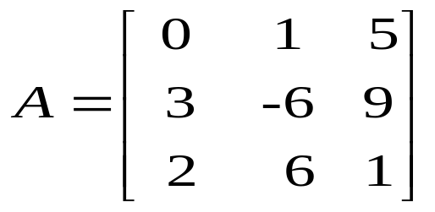
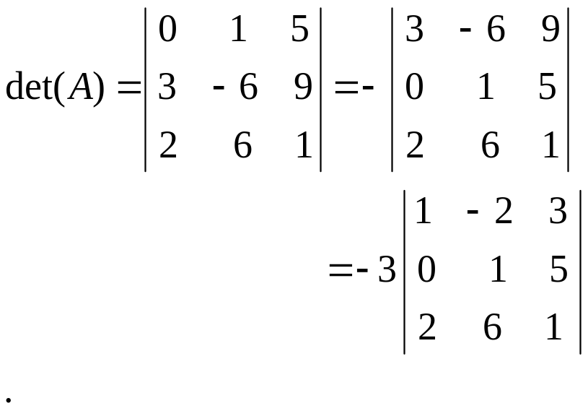
Example 5
Using Row Reduction to Evaluate a Determinant(1/2)
Evaluate det(A) where
Solution:
We will reduce A to row-echelon form and apply theorem 2.2.3
The first and second rows of A are interchanged.
A common factor of 3 from the first row was taken through the determinant sign

Slide 36
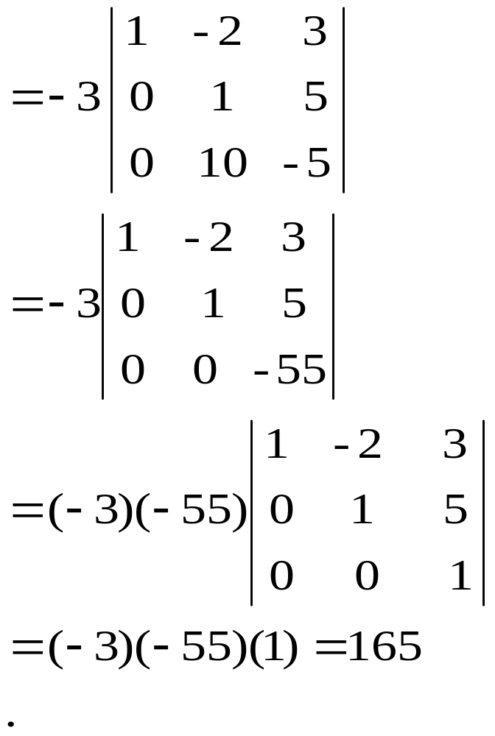
Example 5
Using Row Reduction to Evaluate a Determinant(2/2)
-2 times the first row was added to the third row.
-10 times the second row was added to the third row
A common factor of -55 from the last row was taken through the determinant sign.

Slide 37
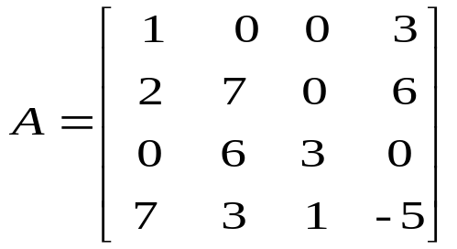
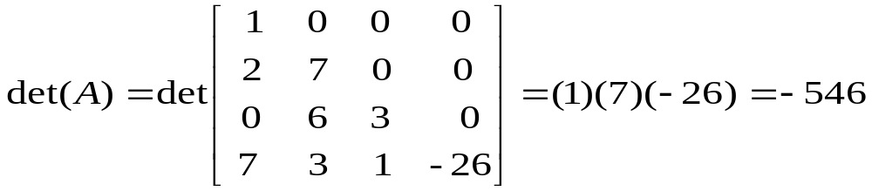
Example 6
Using Column Operation to Evaluate a Determinant
Compute the determinant of
Solution:
We can put A in lower triangular form in one step by adding -3 times the first column to the fourth to obtain

Slide 38
2.3 Properties of The Determinant Function

Slide 39

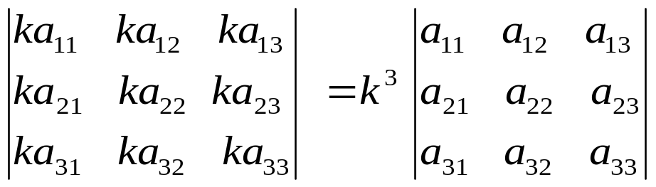
Basic Properties of determinant(1/2)
Suppose that A and B are nxn matrices and k is any scalar. We begin by considering possible relationships between det(A), det(B), and det(kA), det(A+B), and det(AB)
Since a common factor of any row of a matrix can be moved through the det sign, and since each of the n row in kA has a common factor of k, we obtain
(1)
For example,

Slide 40
Basic Properties of determinant(2/2)
There is no simple relationship exists between det(A), det(B), and det(A+B) in general. In particular, we emphasize that det(A+B) is usually not equal to det(A)+det(B).

Slide 41
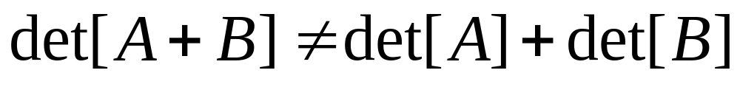
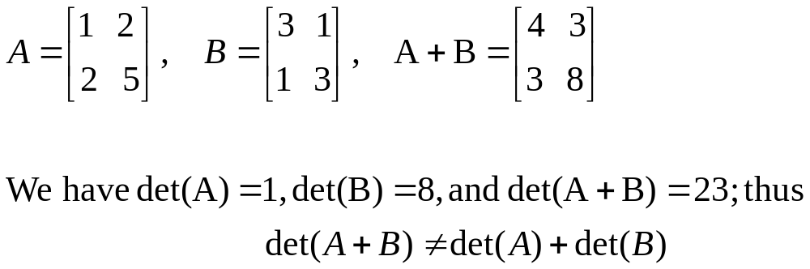
Example 1
Consider

Slide 42
Theorem 2.3.1
Let A, B, and C be nxn matrices that differ only in a single row, say the rth, and assume that the rth row of C can be obtained by adding corresponding entrues in the rth rows of A and B. Then
det(C) = det(A)+det(B)
The same result holds for columns

Slide 43
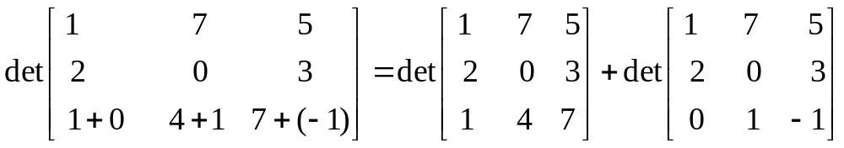
Example 2
Using Theorem 2.3.1
By evaluating the determinants

Slide 44
Lemma 2.3.2
If B is an nxn matrix and E is an nxn elementary matrix, then
det(EB) = det(E)det(B)

Slide 45
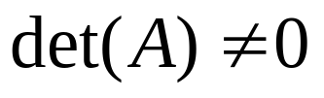
Theorem 2.3.3
Determinant Test for Invertibility
A square matrix A is invertible if and only if

Slide 46
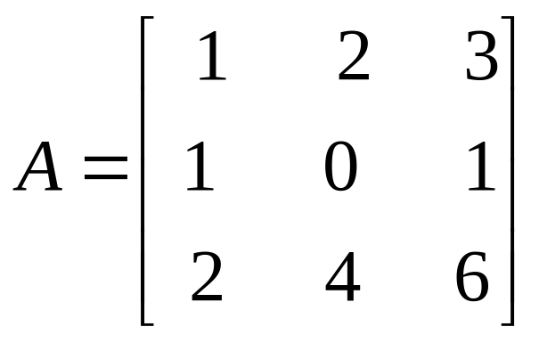
Example 3
Determinant Test for Invertibility
Since the first and third rows of
are proportional, det(A) = 0. Thus, A is not invertible

Slide 47
Theorem 2.3.4
If A and B are square matrices of the same size, then
det(AB)=det(A)det(B)

Slide 48
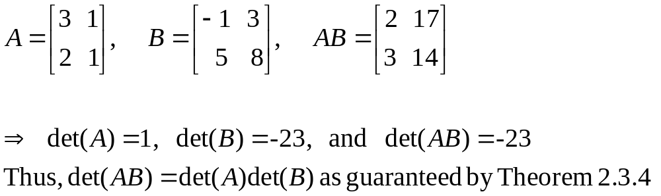
Example 4
Verifying That det[AB]=det[A]det[B]
Consider the matrices

Slide 49
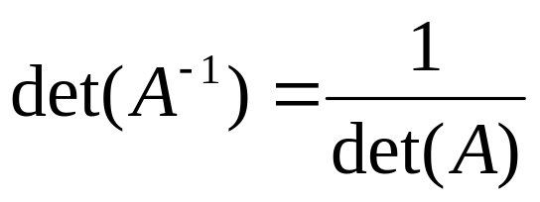
Theorem 2.3.5
If A is invertible, then

Slide 50


Many applications of linear algebra are concerned with systems of n system of n linear equations in n unknowns that are expressed in the form
where is a scalar. Such systems are really homogeneous linear in disguise, the expresses can be rewritten as or, by inserting an identity matrix and factoring, as

Slide 51
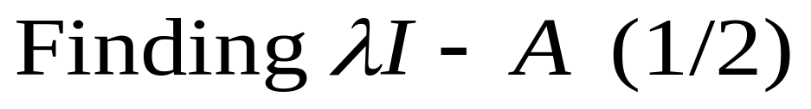
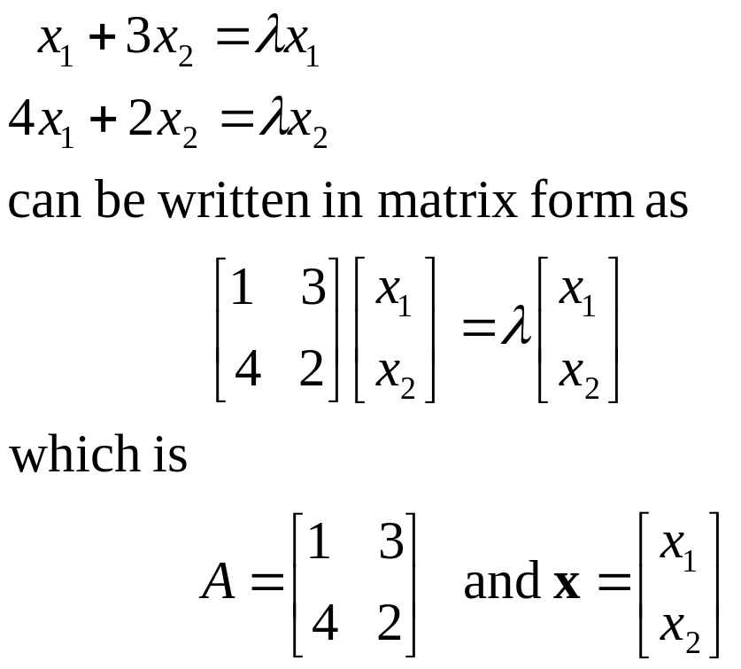
Example 5
The linear system

Slide 52
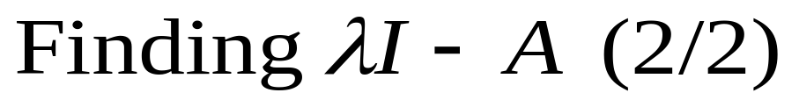
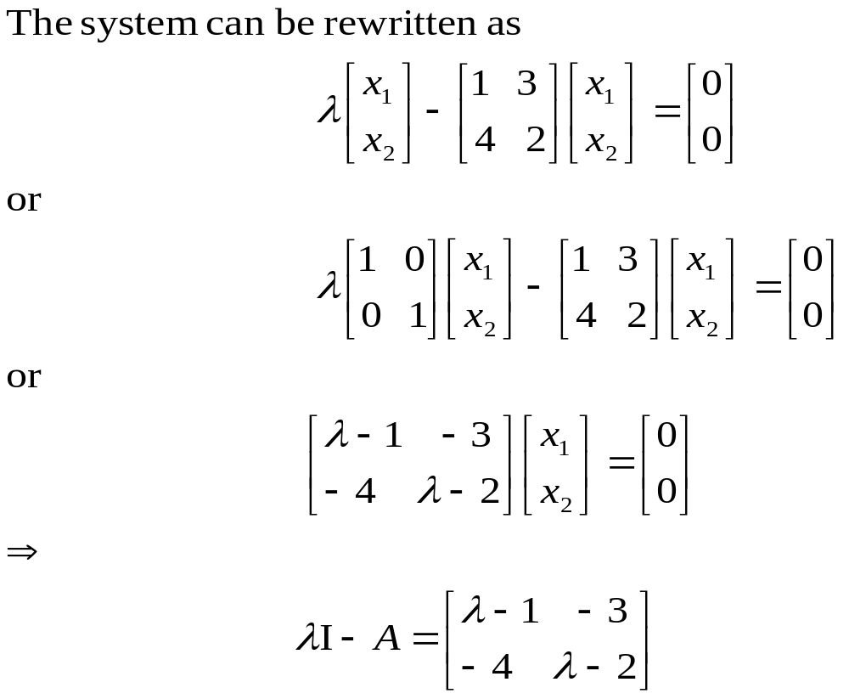
Example 5

Slide 53

Eigenvalue and Eigenvector(1/2)
The primary problem of interest for linear systems of the form (7) is to determine those values of for which the system has a nontrivial solution ; such a value of is called a characteristic value or an eigenvalue of A.
If is an eigenvalue of A, then the nontrivial solutions of (7) are called the eigenvectors of A corresponding to .

Slide 54

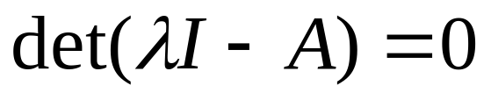
Eigenvalue and Eigenvector(2/2)
It follows from Theorem 2.3.3 that the system has a nontrivial solution if and only if
This is called the characteristic equation of A; the eigenvalues of A can be found by solving this equation for

Slide 55
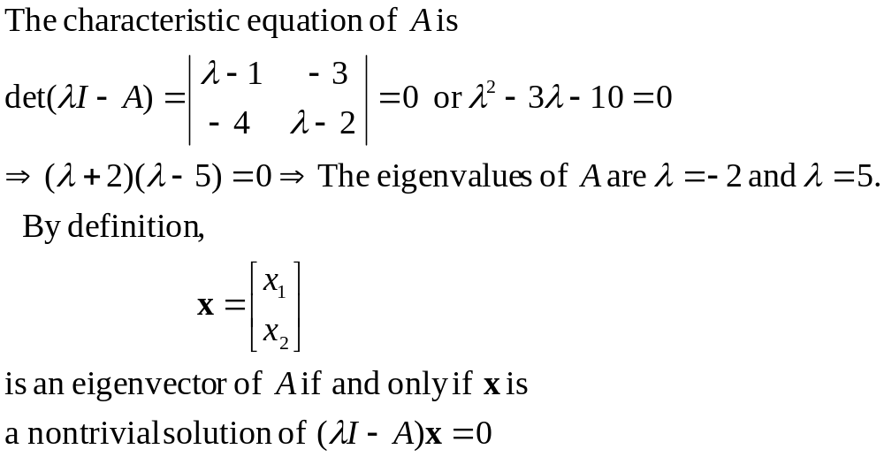
Example 6
Eigenvalues and Eigenvectors(1/3)
Find the eigenvalues and corresponding eigenvectors of the matrix A in Example 5
Solution:

Slide 56
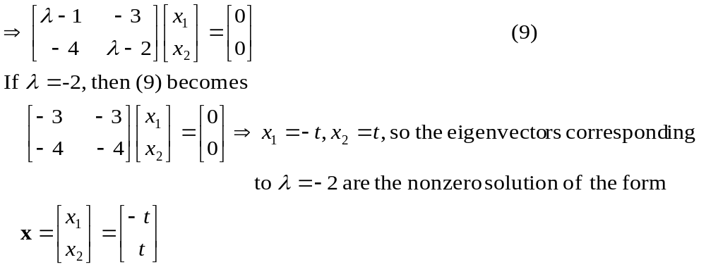

Example 6
Eigenvalues and Eigenvectors(2/3)

Slide 57
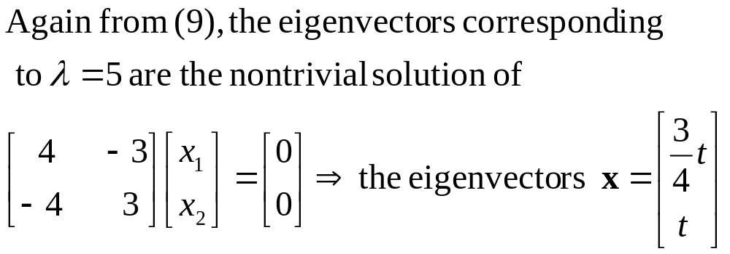
Example 6
Eigenvalues and Eigenvectors(3/3)

Slide 58

Theorem 2.3.6
Equivalent Statements
If A is an nxn matrix, then the following are equivalent.
(a) A is invertible.
(b) Ax=0 has only the trivial solution
(C) The reduced row-echelon form of A as I_{n}
(d) A is expressible as a product of elementary matrices
(e) Ax = b is consistent for every nx1 matrix b
(f) Ax = b has exactly one solution for every nx1 matrix b
(g)

Slide 59
2.4 Cofactor Expansion; Cramer’s Rule

Slide 60
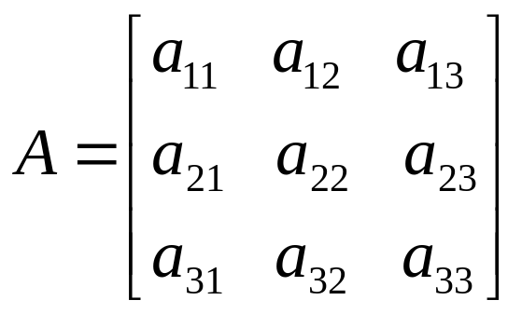
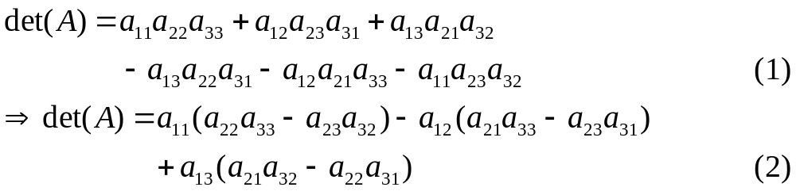
Minors and Cofactors(1/2)
The determinant of a 3x3 matrix
is the number

Slide 61
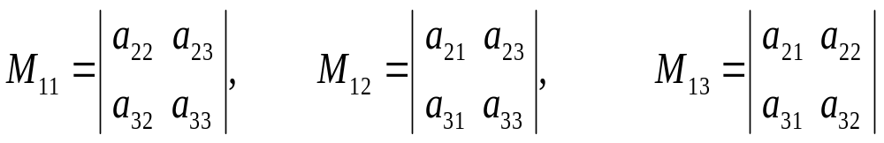
Minors and Cofactors(2/2)
We can get

Slide 62
Definition
If A is a square matrix, then the minor of entry a_{ij} is denoted by M_{ij} and is defined to be the determinant of the submatrix that remains after the ith row and jth column are deleted from A. The number (-1)^{i+j}M_{ij} is denoted by C_{ij} and is called the cofactor of entry a_{ij}.

Slide 63
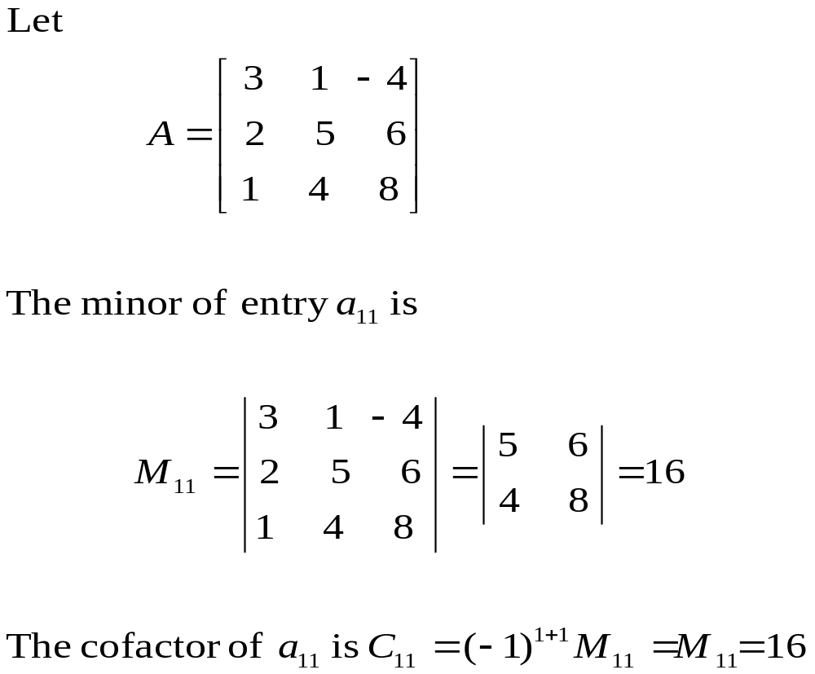
Example 1
Finding Minors and Cofactors(1/2)

Slide 64
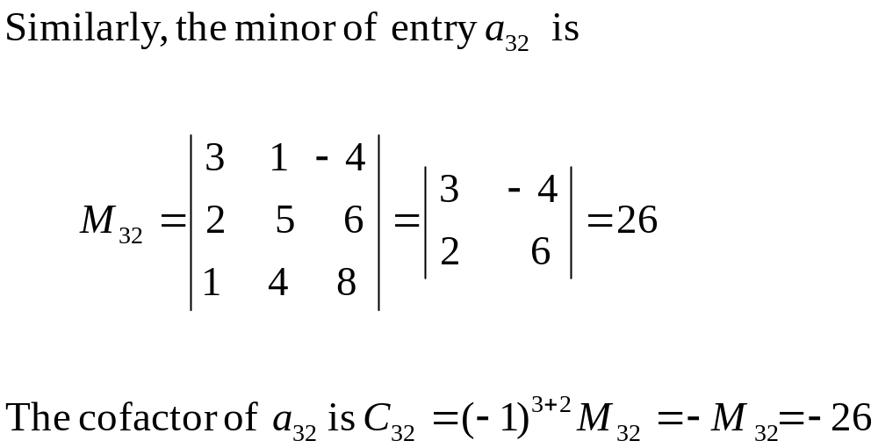
Example 1
Finding Minors and Cofactors(2/2)

Slide 65
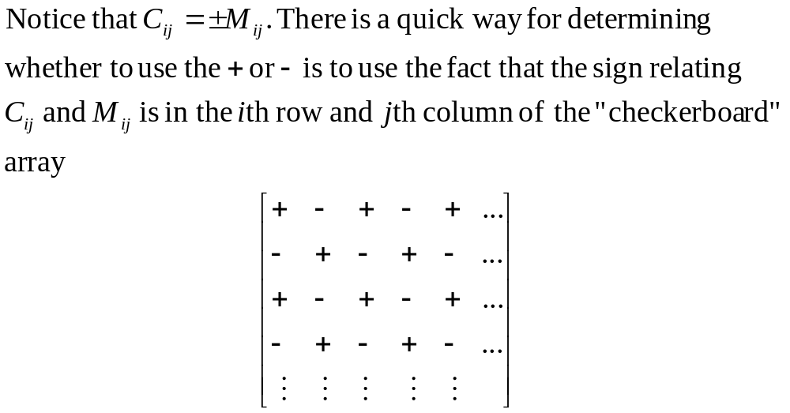
The Relationship Between Minors and Cofactors

Slide 66
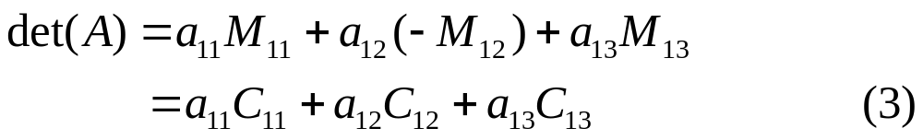
Cofactor Expansions(1/2)
The expression in (2) can be written in terms of minors and cofactors as
This method of evaluating det(A) is called cofactor expansion along the first row of A.

Slide 67
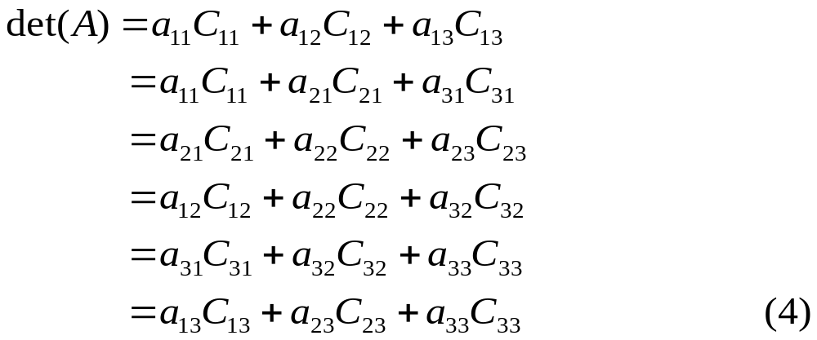
Cofactor Expansions(1/2)
By rearranging the term in (1), we can obtain

Slide 68


Example 2
Cofactor Expansion Along the First Row
solution:

Slide 69

Theorem 2.4.1
Expansions by Cofactors
The determinant of an nxn matrix A can be computed by multiplying the entries in any row (or column) by their cofactors and adding the resulting products; that is, for each
and
(cofactor expansion along the jth column)
(cofactor expansion along the ith row)

Slide 70

Example 3
Cofactor Expansion Along the First column
Let A be the matrix in Example 2. Evaluate det(A) by cofactor expansion along the first column of A
Solution:

Slide 71


Example 4
Row Operation and Cofactor Expansion(1/2)
Evaluate det(A) where
Solution:

Slide 72

Example 4
Row Operation and Cofactor Expansion(2/2)
Cofactor expansion along the first column
We added the first row to the third row.
Cofactor expansion along the first column

Slide 73

Example 5
Entries and Cofactors from Different Rows(1/2)

Slide 74

Example 5
Entries and Cofactors from Different Rows(2/2)

Slide 75



definition
If A is any nxn matrix and is the cofactor of , then the matrix
is called the matrix of cofactors from A. The transpose of this matrix is called the adjoint of A and is denoted by adj(A)

Slide 76

Example 6
Adjoint of a 3x3 matrix (1/2)

Slide 77

Example 6
Adjoint of a 3x3 matrix (2/2)

Slide 78

Theorem 2.4.2
Inverse of a Matrix Using Its Adjoint

Slide 79

Example &
Using the Adjoint to Find an Inverse Matrix
Use (7) to find the inverse of the matrix A in Example6.
Solution:

Slide 80





Theorem 2.4.3
Cramer’s Rule
If is a system of n linear equations in n unknowns such that , then the system has a unique solution. This solution is
Where is the matrix obtained by replacing the entries in the column of A by the entries in the matrix

Slide 81


Example 8
Using Cramer’s Rule to Solve a Linear System (1/2)
Use Cramer’s rule to solve
Solution:

Slide 82

Example 8
Using Cramer’s Rule to Solve a Linear System (2/2)
Therefore

